Slide 1
DXC Playbooks using Digital Explorer
David Stevens Nov 14th 2018

Slide 2
Aim
Allow users to create dynamic playbooks using the Digital Explorer dataset to tell their story.
Playbooks can either be private or published and shared with other users
Layout:
Freeform opening section (1-x pages)
Markdown supported
3 images (title page and introduction sections 1 per page)
Selection of the top 6 trends
Selection of the top solution showcases
Selection of 1-6 key contacts

Slide 3
Potential Playbooks
Industry POV’s
DXC Technical Excellence showcase solution winners
Dan’s 201x Trends
IoT colouring book
Delivery and Customer Centre briefing packs
DXC Digital Transformation POV

Slide 4
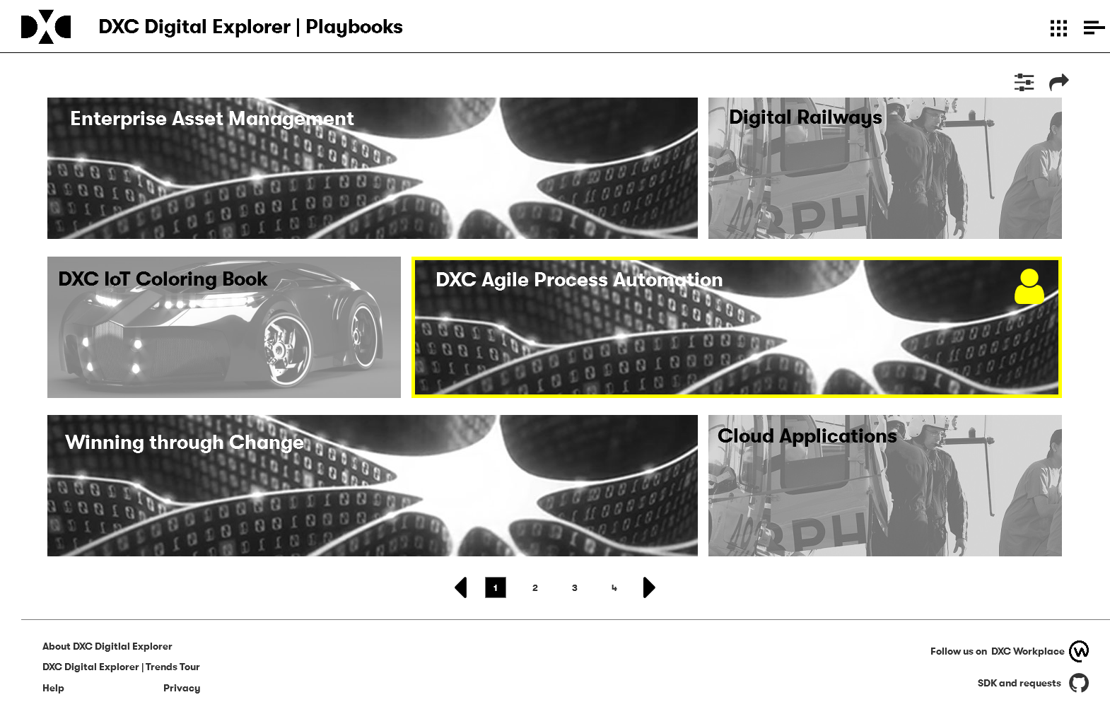
Public and personal playbooks shown on landing page
Option to filter based on Industry, tags, public, private, etc.

Slide 5
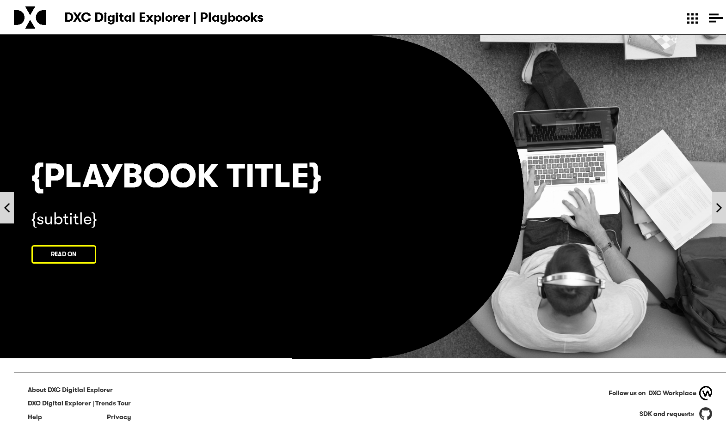
Opening page - direct link would be available
Page transitions “turn” like a book

Slide 6
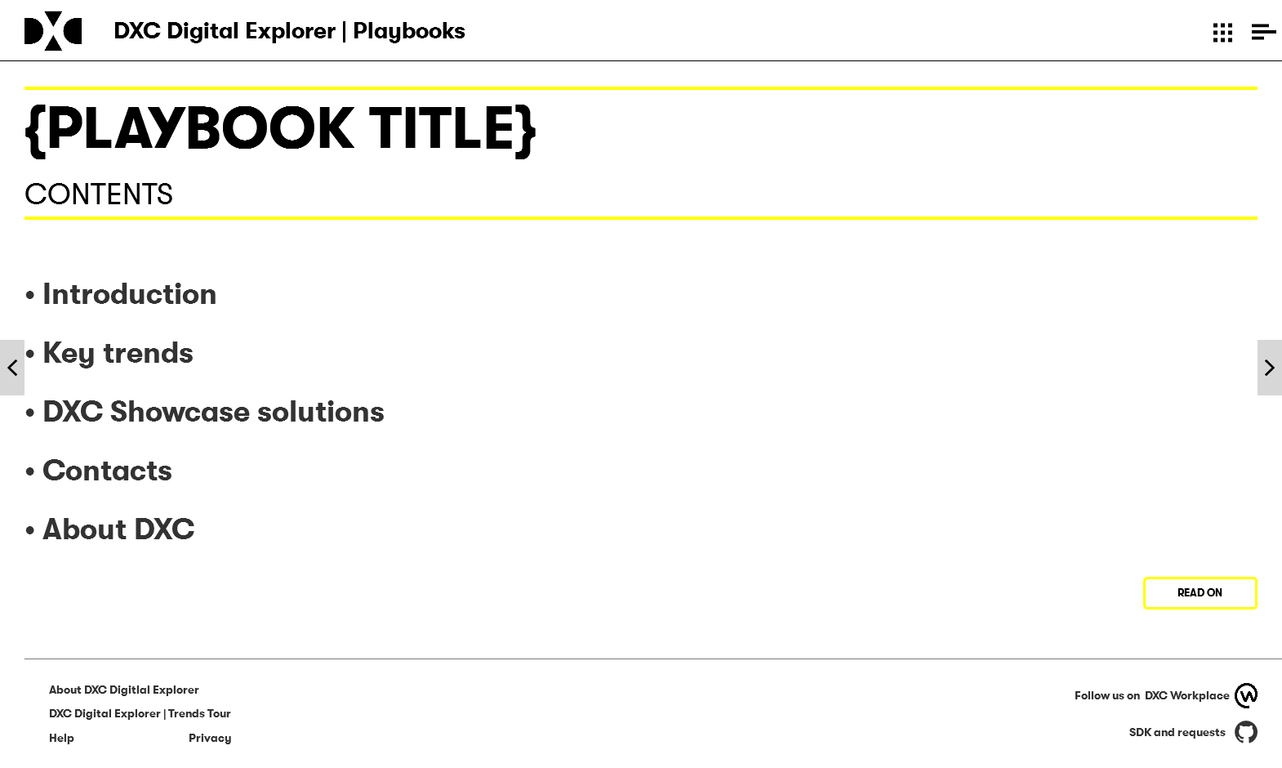
Trends and Solution links only shown if content included

Slide 7
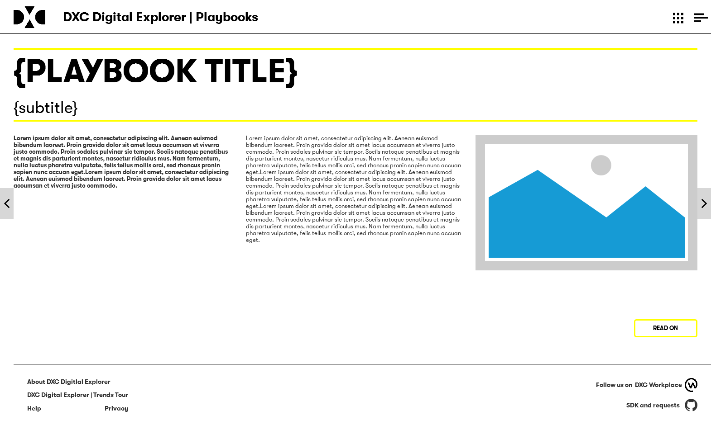
Max 2 pages of these type

Slide 8
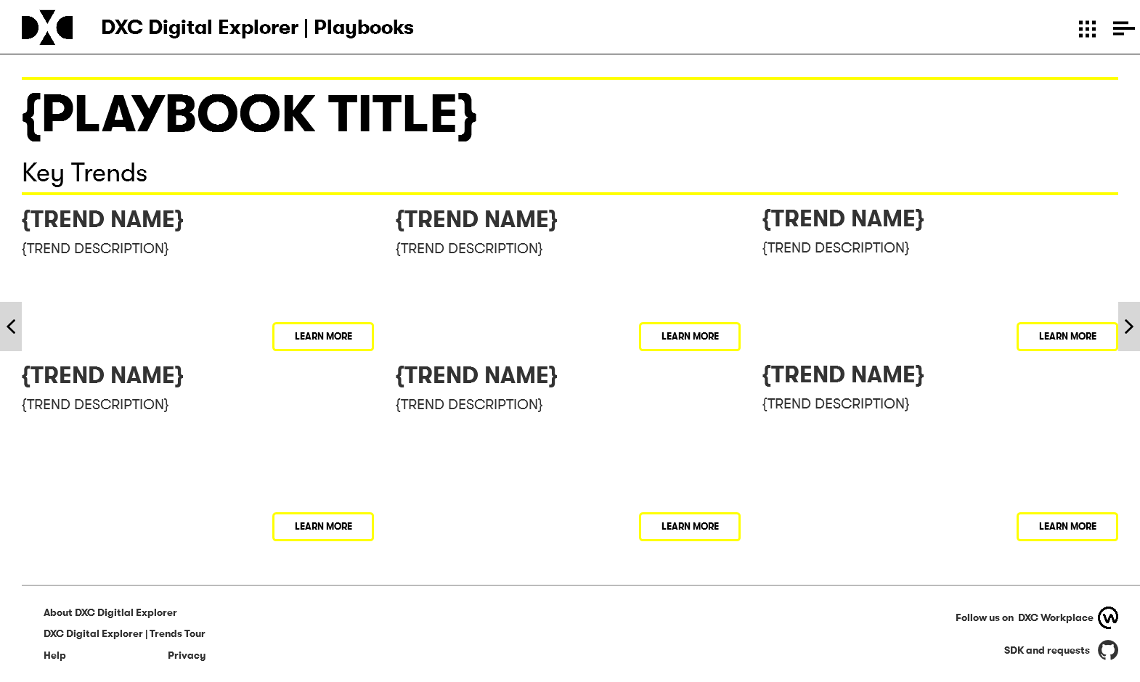
“learn more” open detailed trend information page

Slide 9
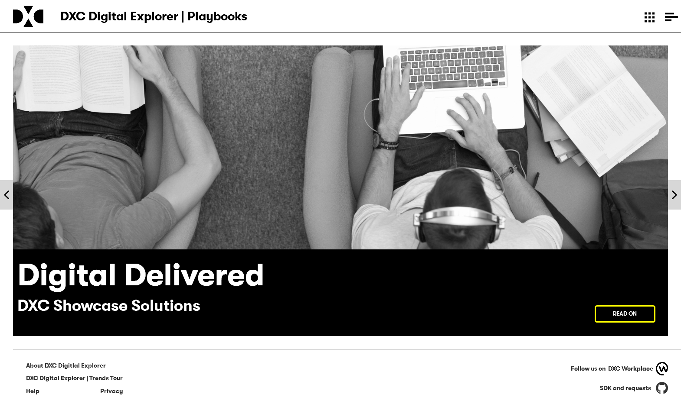
Generic opening page for showcases solutions

Slide 10
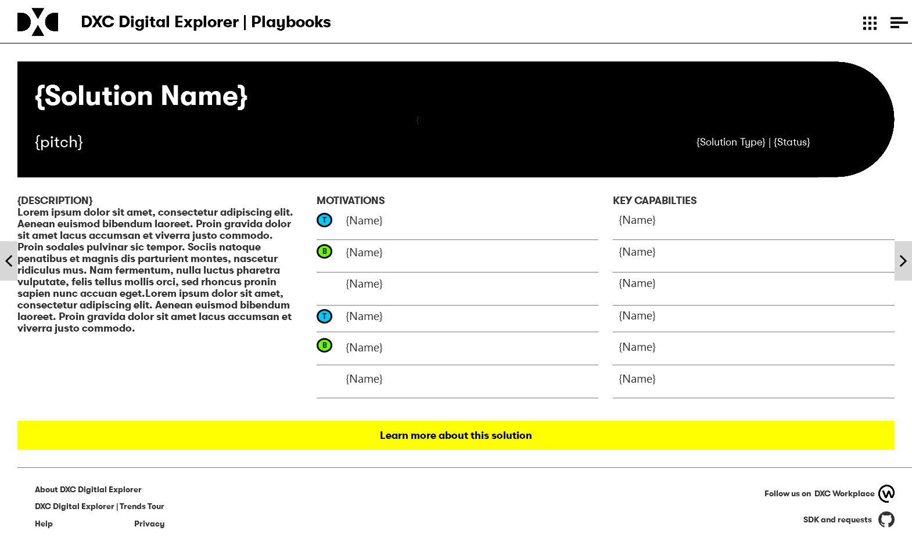
“learn more” opens detailed solution datasheet within Digital Explorer

Slide 11
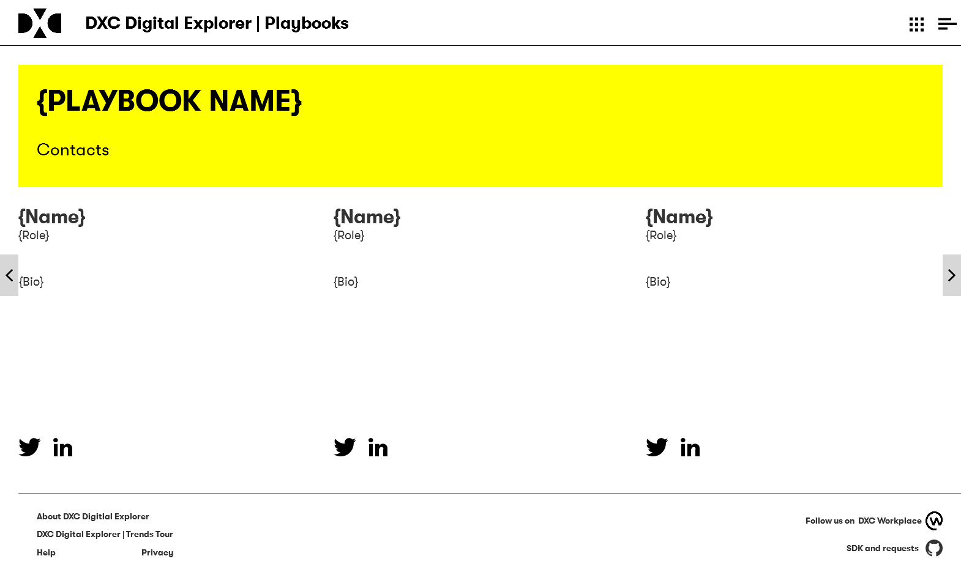
Requires an update to support richer Person profiles

Slide 12
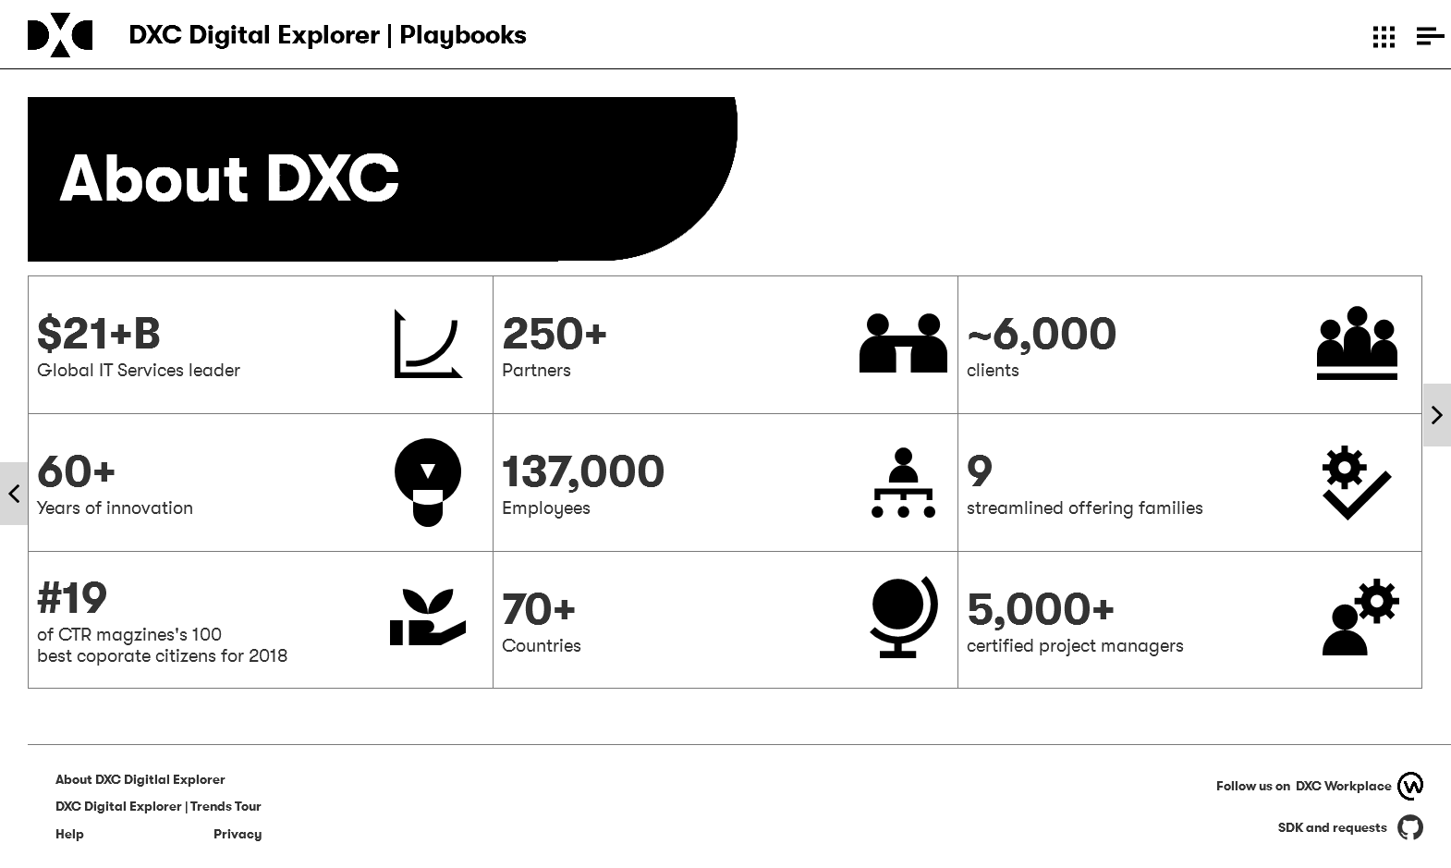
Semi-Static page within all playbooks; i.e. values are mastered as a set of data and shared across all books

Slide 13


Slide 14
PUBLISHER UI

Slide 15
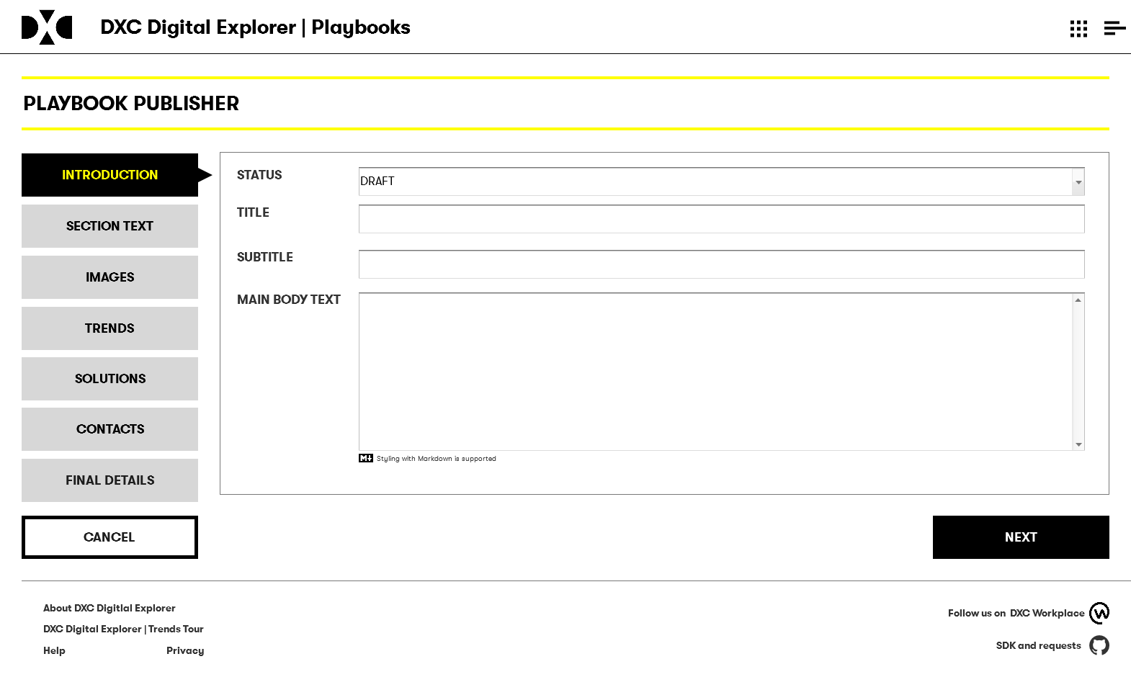

Slide 16
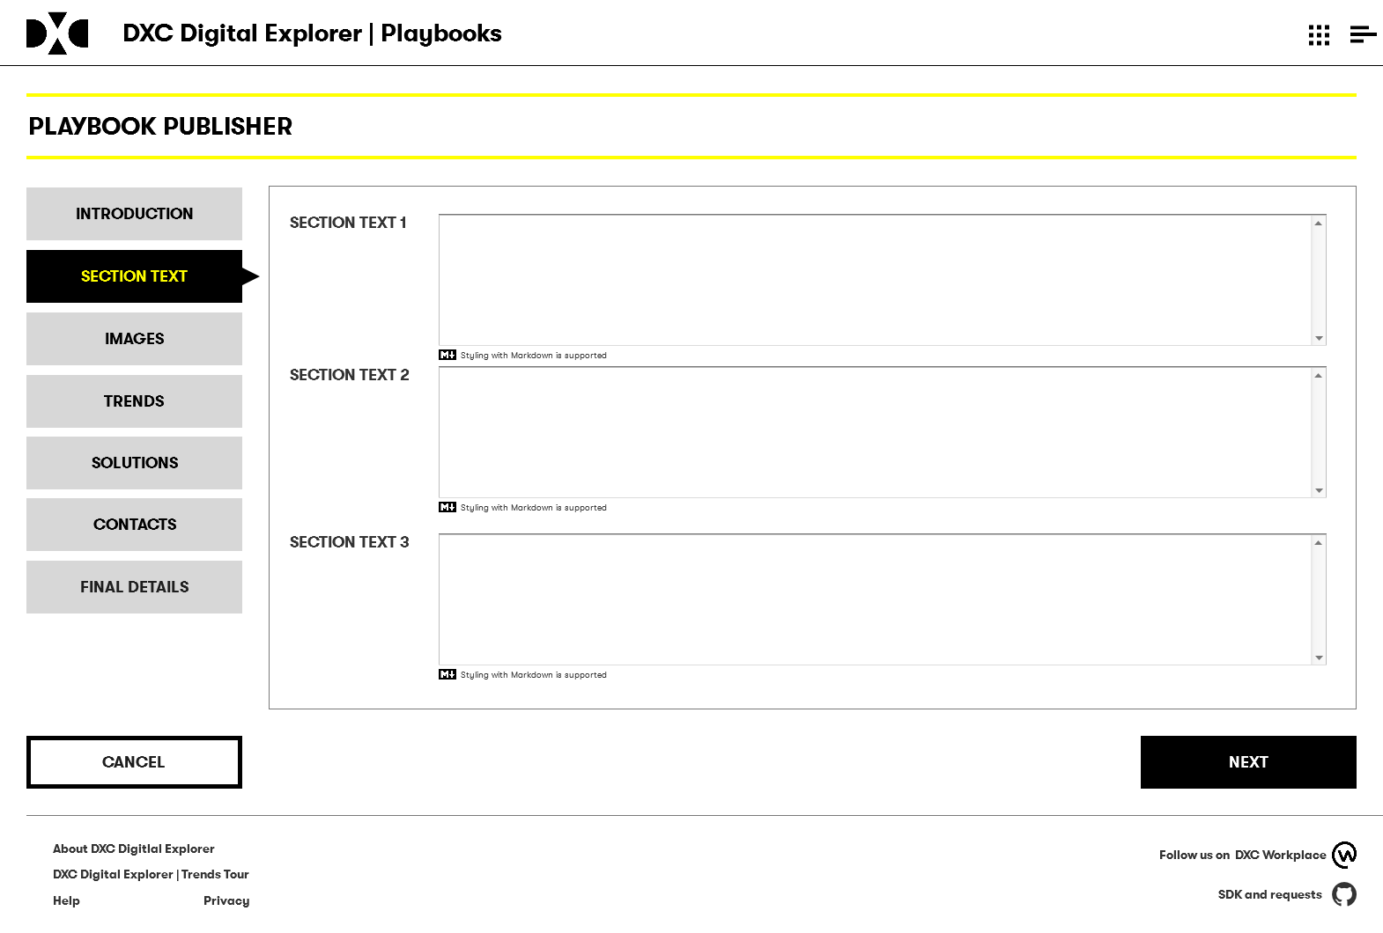
Text will support markdown – bold, links, simple layout options

Slide 17
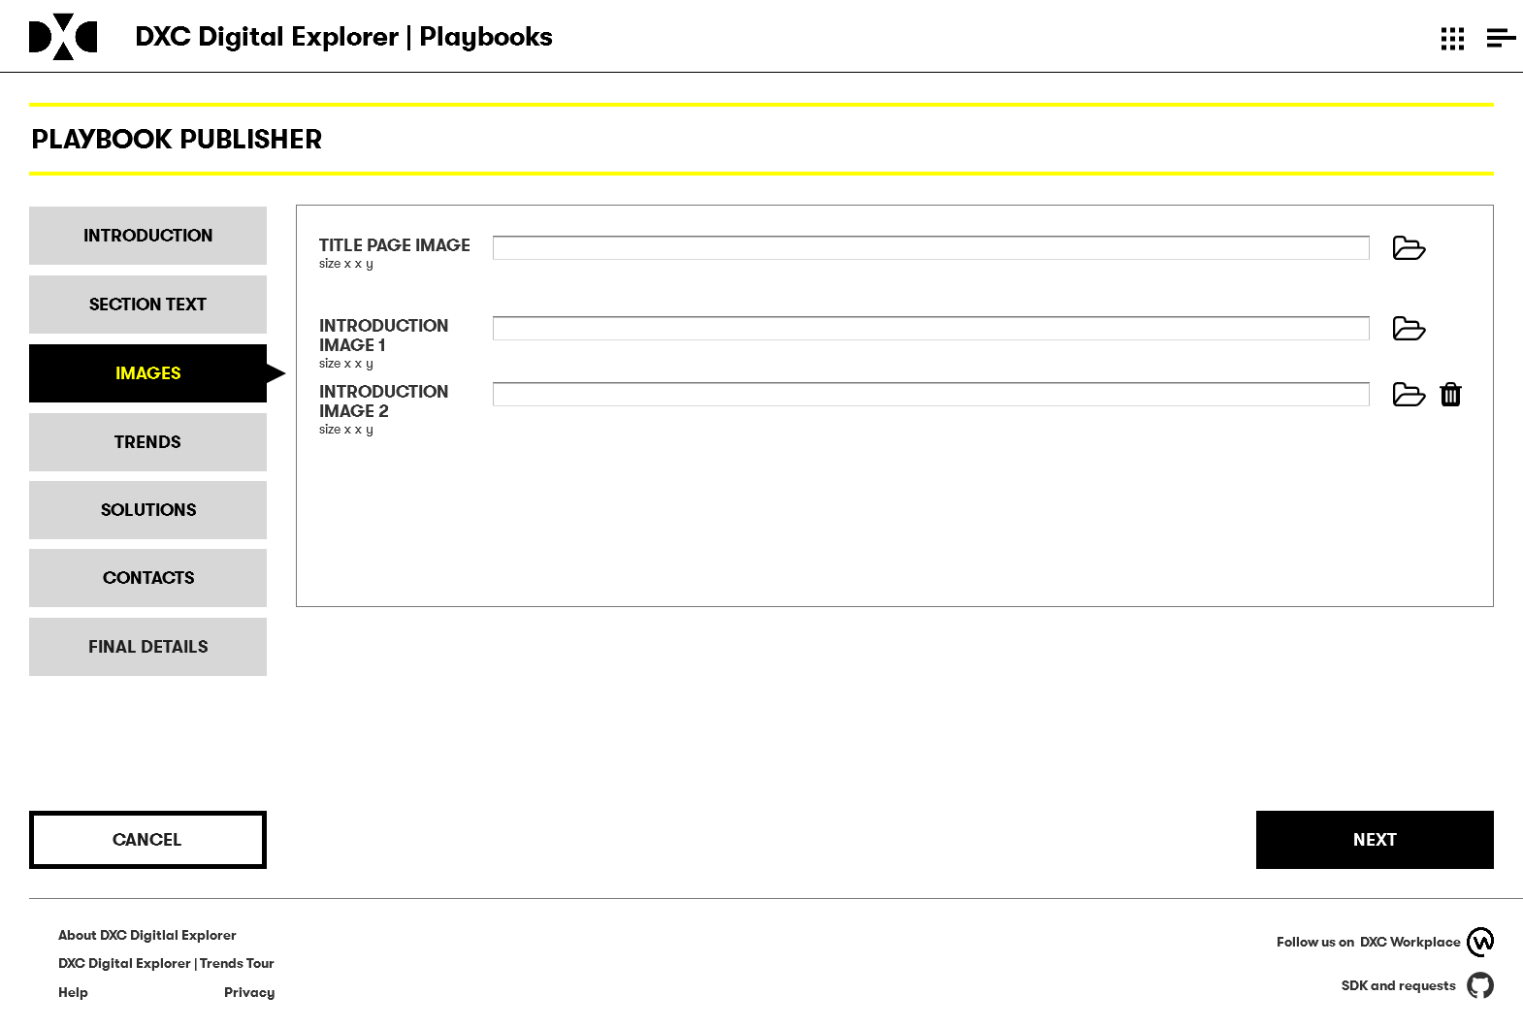

Slide 18
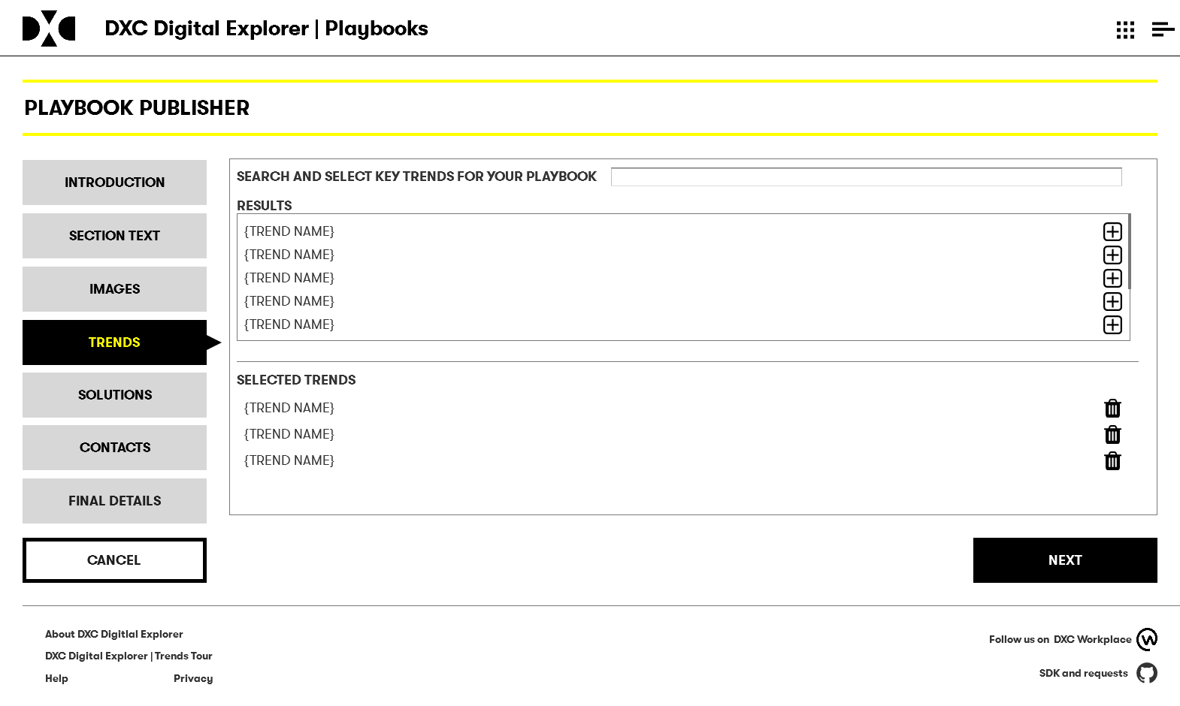

Slide 19
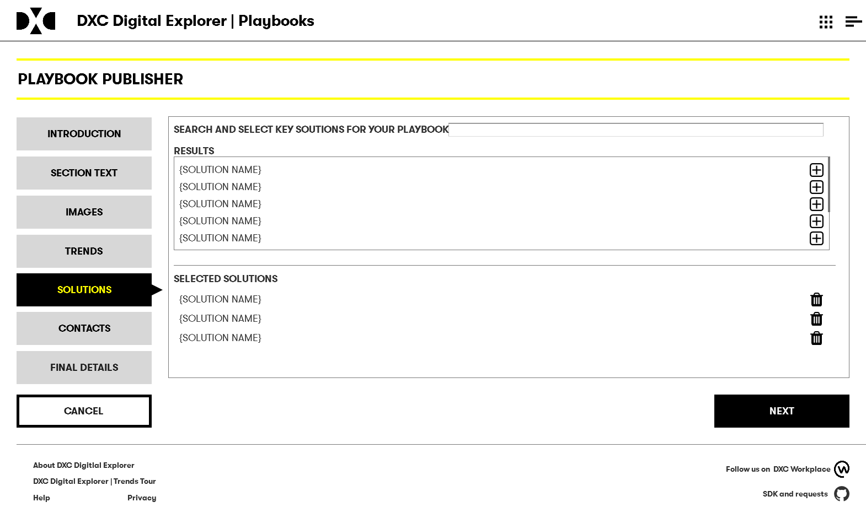
Solutions limited to reference only solutions

Slide 20
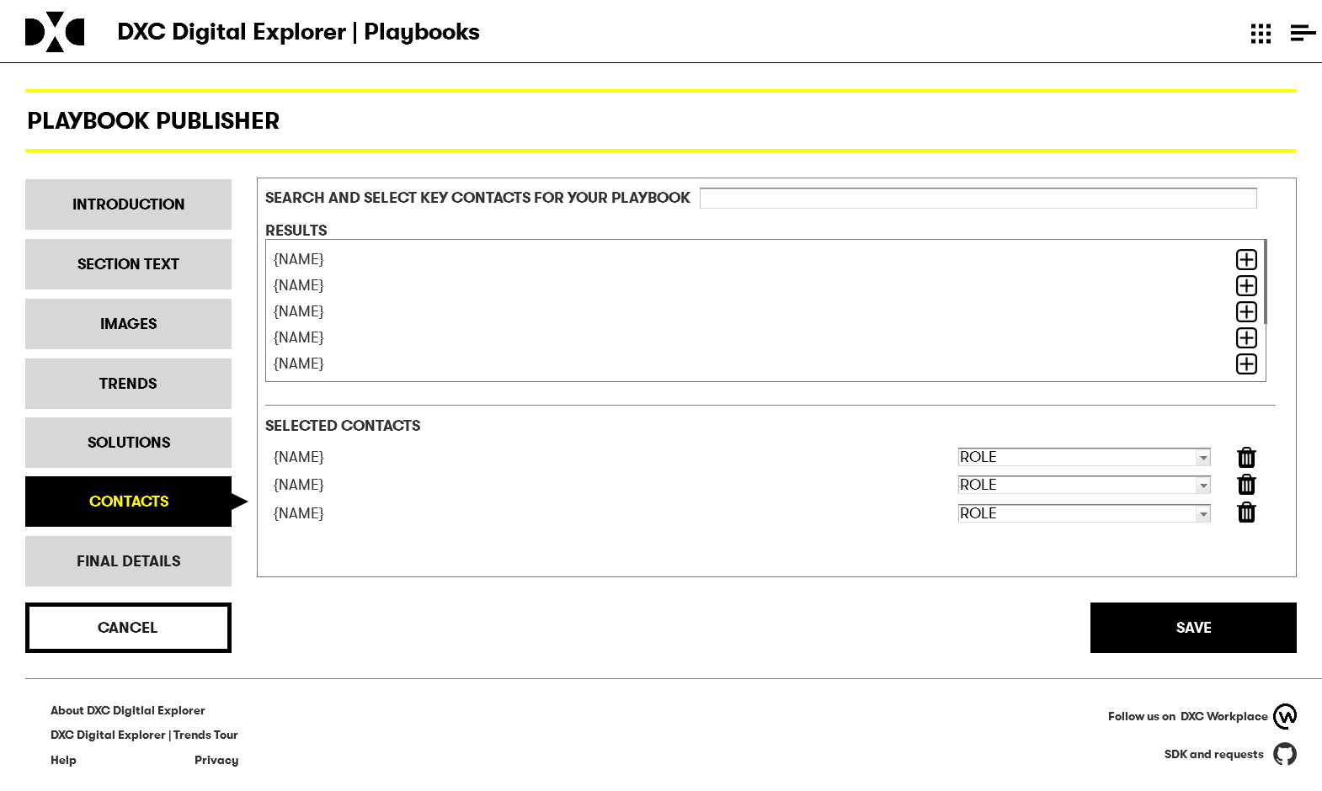

Slide 21
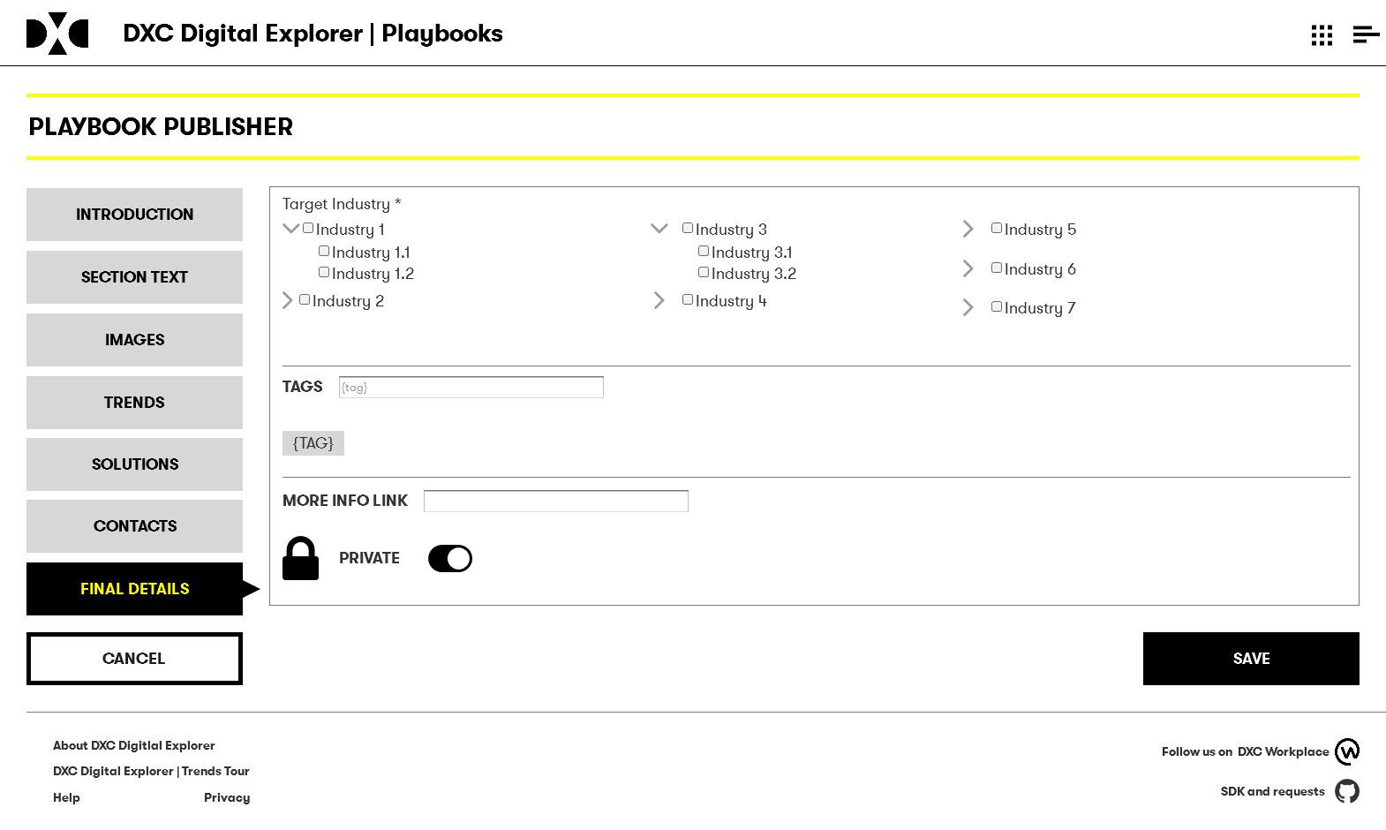
By default books are set to private, default more info link is dxc.com

Slide 22
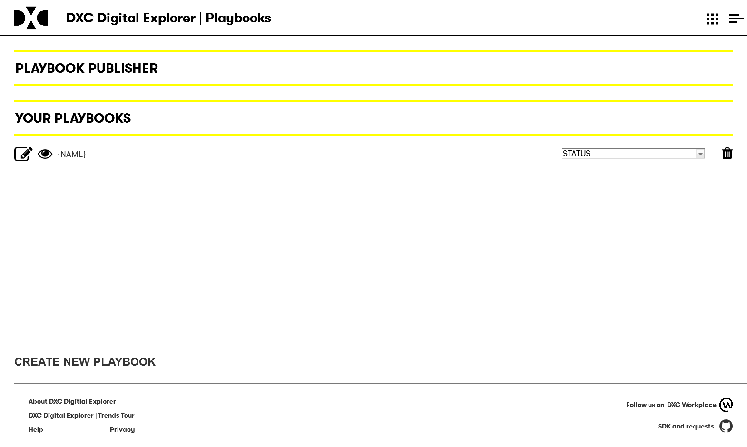

Slide 23
DATA MODEL

Slide 24
Existing data node
Playbook Section
Trends
Solutions
HAS
ASSOCIATED
ASSOCIATED
Playbook
Industry
ASSOCIATED
ASSOCIATED
Person
HAS
Tag
CREATED

Slide 25
About DXC metamodel
Partners
Revenue
Employees
Prefixed with dxc.
{value}
{subtext}
{imageURI}
DXC Metrics
Innovation
Locations
Green
Skills
Portfolio

Slide 26
OTHER REQUIREMENTS

Slide 27
OTHER REQUIREMENTS
Each playbook to have the ability to be tracked within Google Analytics
Investigate at a later stage how to return this to playbook creators
Needs to be open – without authentication – authentication occurs from the “learn more” links
i.e. base dataset shown here is available to any users

